Slide 1
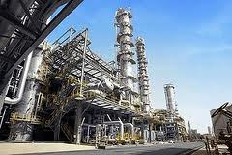
INTRODUCTION TO PETROCHEMICAL INDUSTRY
ChE 253
TOPIC: WATER REMOVAL FROM NATURAL GAS
(DEHYDRATION)
Members: Dussey David
Donkor Kwame Ohene
Darko Richard

Slide 2
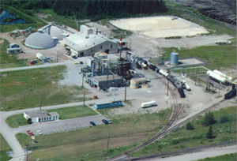
Water removal is an inherent process in the petrochemical industry, especially in the production of natural gas.
It basically involves the dehydration of a hydrocarbon compound or any other compound .
Might sound simple, but becomes a difficulty if one is dealing with volatile compounds like hydrocarbons.

Slide 3

WHY DO yoU THINK WATER MUST BE REMOVED ?

Slide 4
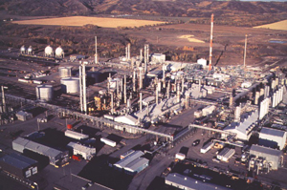
Moisture must be removed from natural gas to reduce corrosion problems and to prevent hydrate formation.
Hydrates are formed from a physical-chemical reaction between hydrocarbons and water under the high pressures and low temperatures used to transport natural gas via pipeline.
Hydrates reduce pipeline efficiency

Slide 5
WATER REMOVAL STRATAGIES
Glycol Dehydration
Injection of Methanol
Solid-Desiccant Dehydration
Gravity Separation
Centrifuge - Spin Your Oil Clean
Vacuum the Oil Dry
Dehydration by Air Stripping
Heat the Oil Dry

Slide 6
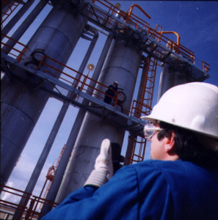
WATER REMOVAL STRATEGIES ASSOCIATED WITH NATURAL GAS.
GLYCOL DEHYDRATION
INJECTION OF METHANOL
SOLID-DESICCANT DEHYDRATION

Slide 7
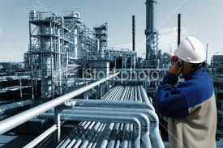
GLYCOL DEHYDRATION.
Glycol dehydration is an absorption dehydration process in which liquid desiccant dehydrator serves to absorb water vapor from the gas stream.
Glycol, the principal agent in this process, has a chemical affinity for water.

Slide 8
Essentially, glycol dehydration involves using a glycol solution.
They are brought into contact with the wet gas stream in what is called the 'contactor'.
Usually either diethylene glycol (DEG) or triethylene glycol (TEG)) are used.

Slide 9
Diethylene glycol (DEG) It is a colorless, practically odorless, poisonous, viscous, and hygroscopic liquid with a sweetish taste.
Molecular formula (HOCH₂CH₂)₂O.
IUPAC name (2-hydroxyethoxy)ethan-2-ol

Slide 10
Triethylene glycol, TEG, or triglycol is a colorless odorless viscous liquid
Molecular formula HOCH₂CH₂OCH₂CH₂OCH₂CH₂OH.
IUPAC name: 2-[2-(2-Hydroxyethoxy) ethoxy]ethanol
It is used as a plasticizer for vinyl.

Slide 11
Procedures
The glycol solution will absorb water from the wet gas.
Once absorbed, the glycol particles become heavier and sink to the bottom of the contactor where they are removed.
The natural gas, having been stripped of most of its water content, is then transported out of the dehydrator.

Slide 12
The glycol solution, bearing the water stripped from the natural gas, is put through a specialized boiler designed to vaporize only the water out of the solution.
While water has a boiling point of 100 º Ϲ, glycol does not boil until 204.4 º Ϲ.
This boiling point differential makes it relatively easy to remove water from the glycol solution, allowing it be reused in the dehydration process.

Slide 13
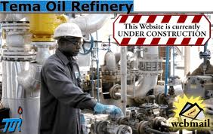
WHY IS GLYCOL DEHYDRATION PREFFERED.
Low initial cost.
Lower energy requirements
Lower pressure drops.
Continuous operation.

Slide 14
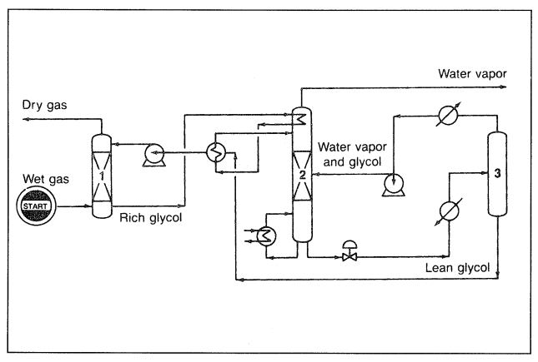

Slide 15
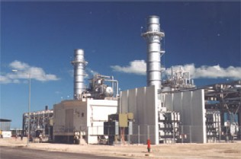
SOLID-DESICCANT
These systems are best suited for large volumes of gas under very high pressure, and are thus usually located on a pipeline downstream of a compressor station.
Two or more towers are required because the desiccant in a particular tower becomes saturated with water.
Examples include activated alumina or a granular silica gel material.

Slide 16
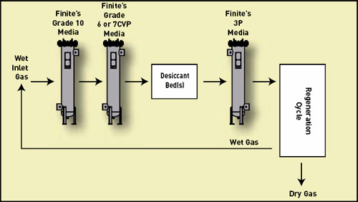
Flow chart for Solid dessicant

Slide 17
Two or more towers, filled with a solid desiccant such as silica gel or molecular sieve.
The natural gas is then sent through a regeneration cycle.
In this cycle, dry gas exits the bed, is cooled, and wet gas is diverted back to the wet inlet gas stream.

Slide 18
To 'regenerate' the desiccant, a high-temperature heater is used to heat gas to a very high temperature.
Passing this heated gas through a saturated desiccant bed vaporizes the water in the desiccant tower.
Leaving it dry and allowing for further natural gas dehydration.

Slide 19
INJECTION OF METHANOL
Methanol, also known as methyl alcohol, wood alcohol, wood naphtha.
Chemical formula CH₃OH .
At room temperature it is a polar liquid

Slide 20
It is the simplest alcohol, light, volatile, colorless, flammable, liquid with a distinctive odor that is very similar to but slightly sweeter than ethanol (drinking alcohol).

Slide 21
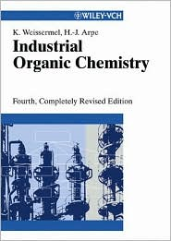

References
Industrial Organic Chemistry
Fourth Edition © 2003
Klaus Weissermel, Hans-Jurgen Arpe
Chemistry of Petrochemical Processes
2nd Edition, © 2001
Sami Matar and Lewis F. Hatch

Slide 22
Wikipedia
Natural Gas.org

